Slide 1
Section N
Nucleotide Metabolism
Guodong Yang
Biochemistry and Molecular Biology, College of Life Sciences
gdyang@sdau.edu.cn
13854808762

Slide 2
Radioisotope tracer experiments revealed the origins of the atoms in the purine and pyrimidine rings

Slide 3
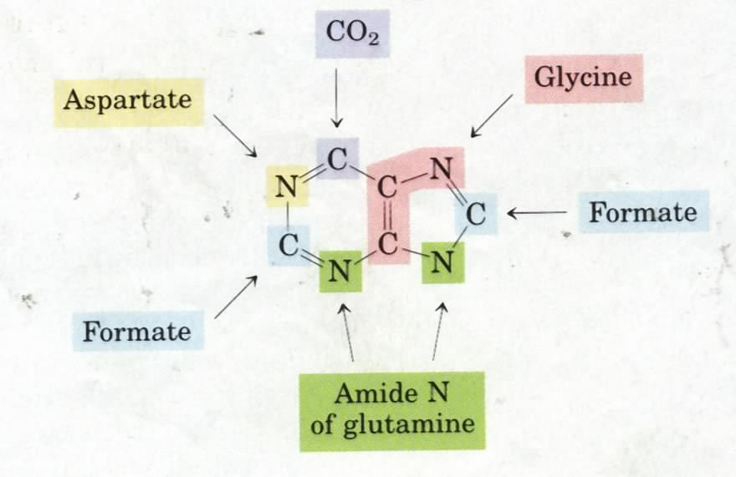
5
origins of the ring
atoms of purines
(numbered is the
order of addition)
6
2
3
7
1
4
Ribose 5-P
imidazole ring first

Slide 4
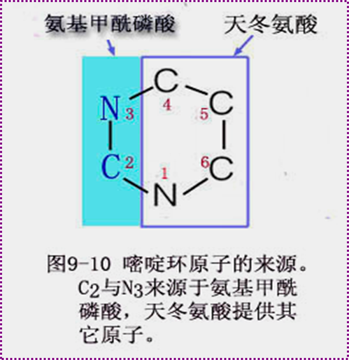
Carbamoyl phosphate
Aspartate
-
HCO3
The atoms of the pyrimidine rings were revealed to
be derived from HCO₃⁻, Gln and Asp.

Slide 5
De novo purine nucleotide synthesis: the base assembles on the ribose phosphate; IMP is first nucleotide synthesized.

Slide 6
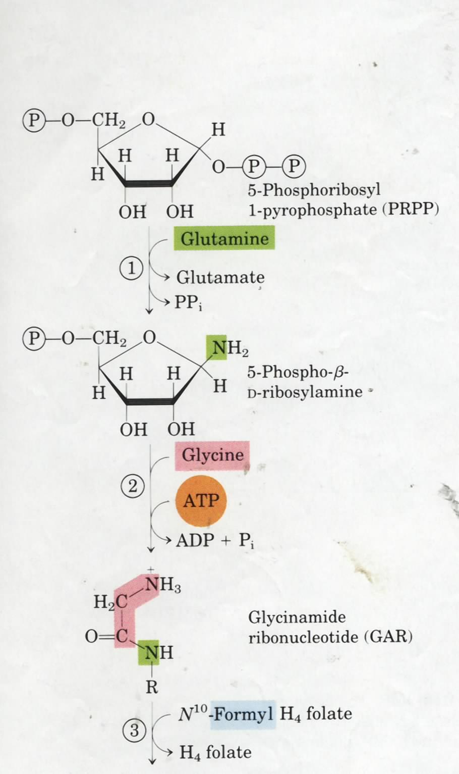
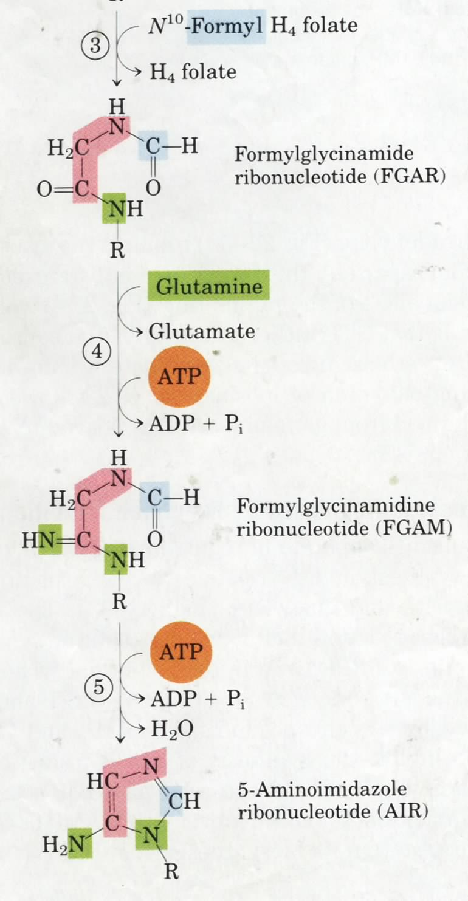
The purine ring is built up one or three
atoms at a time on ribose 5-P
Committing
step
(Unstable)
1, 3, 5 are
catalyzed by
one protein!

Slide 7
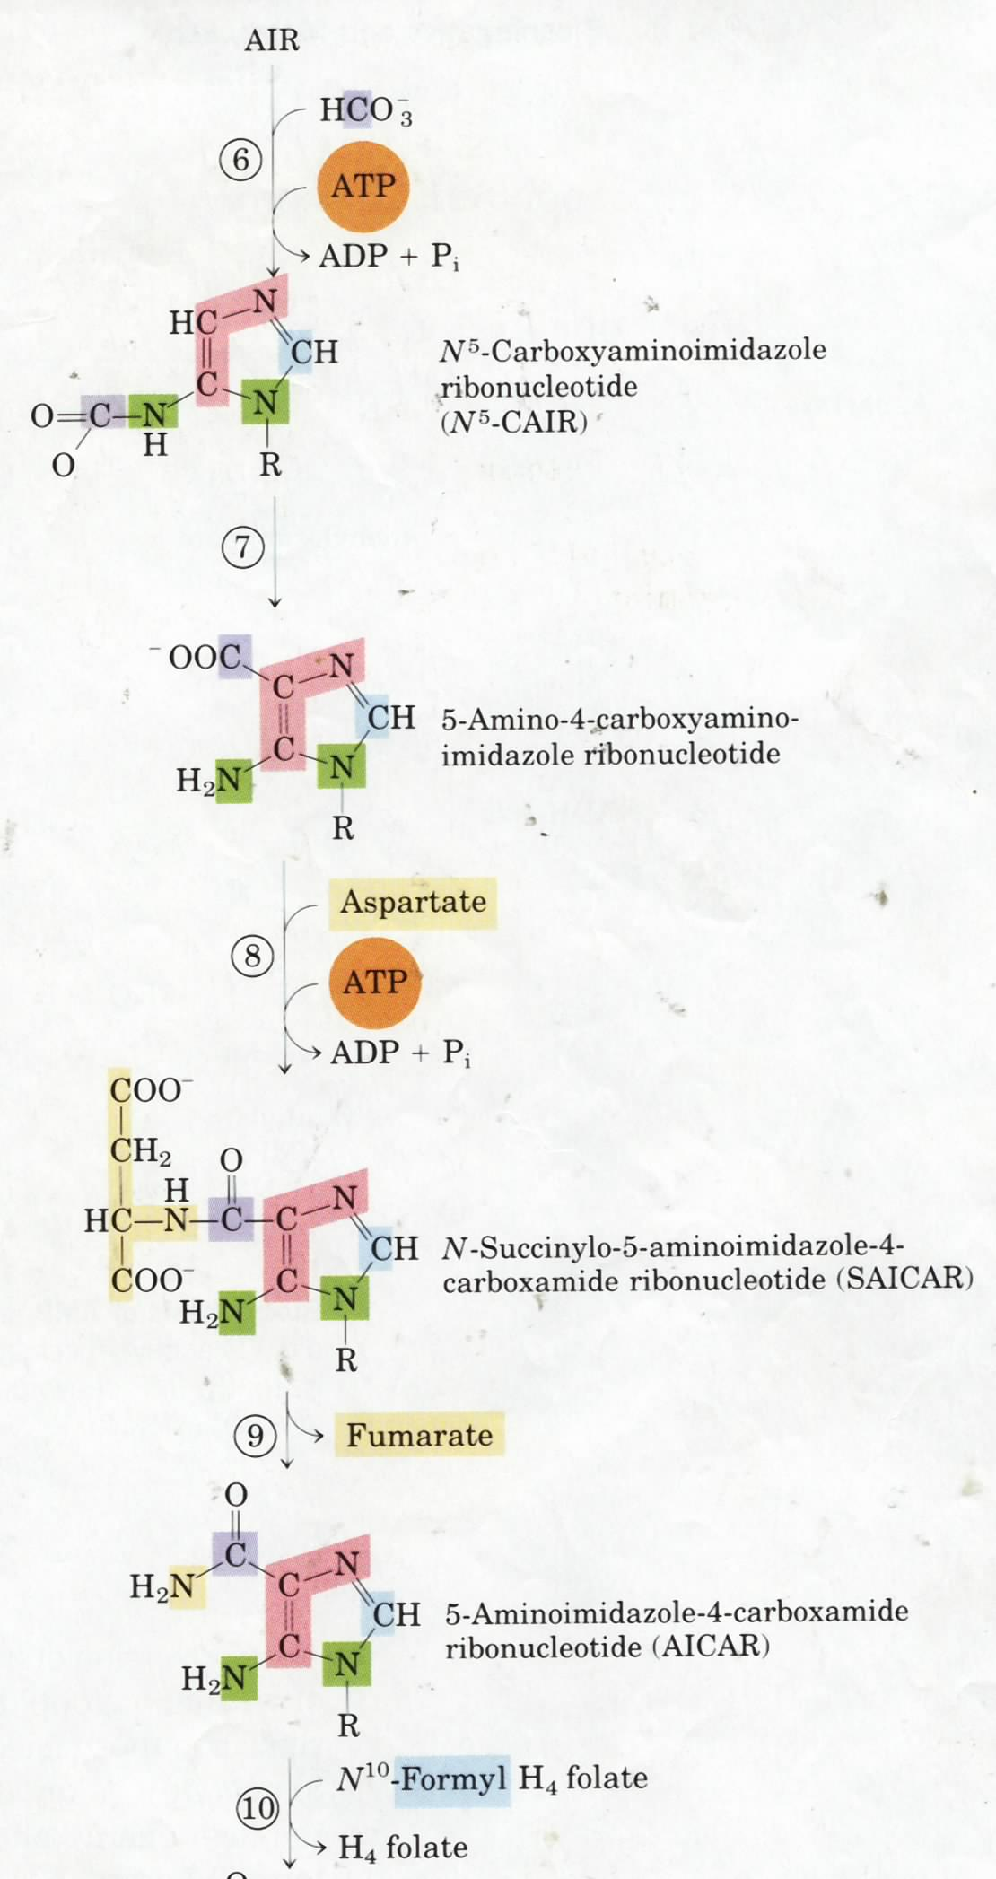
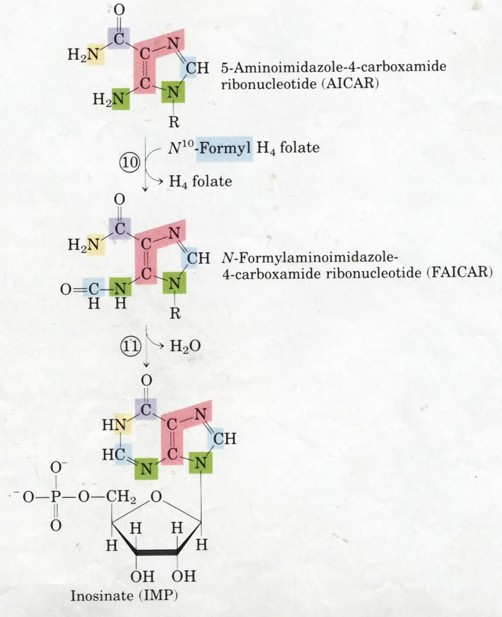
By-product of His
biosynthesis
Biotin is
not needed!
7 and 8 are catalyzed
by one bifunctional
enzyme
10 and 11 are catalyzed by
one bifunctional enzyme
IMP is first
formed before
being converted
to AMP and
GMP.

Slide 8
De novo purine nucleotide synthesis: AMP and GMP are derived from IMP.
Next

Slide 9
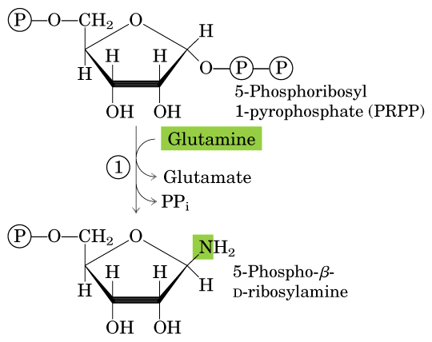

Slide 10
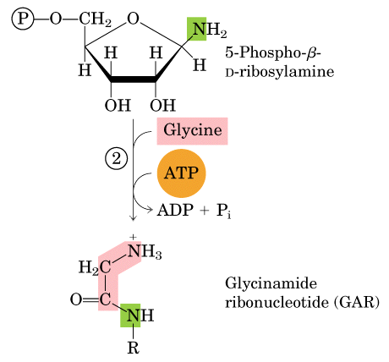

Slide 11
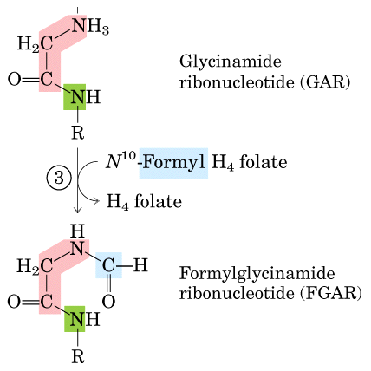

Slide 12
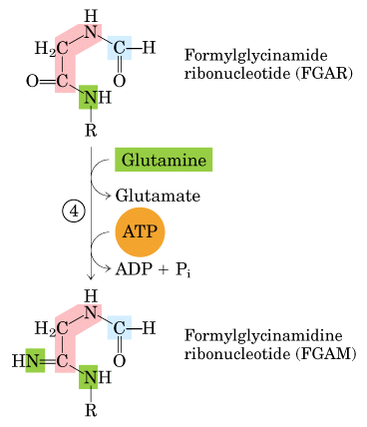

Slide 13
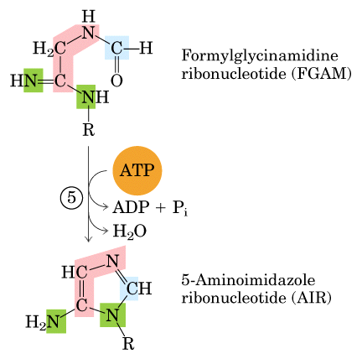

Slide 14
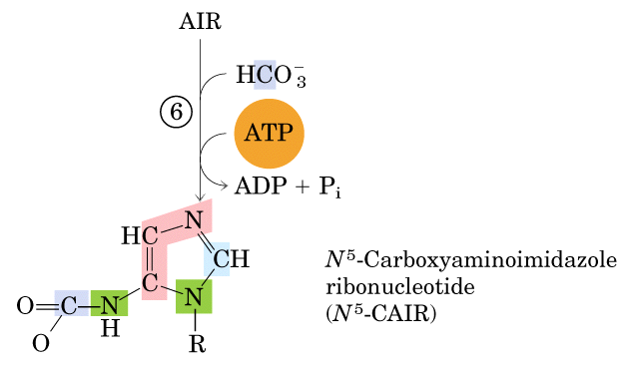

Slide 15
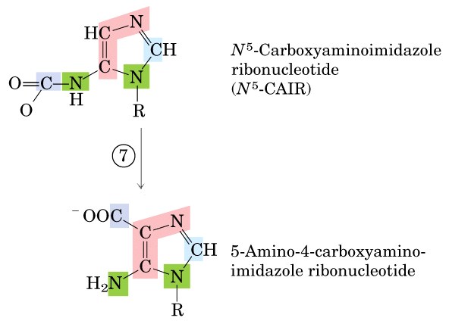

Slide 16
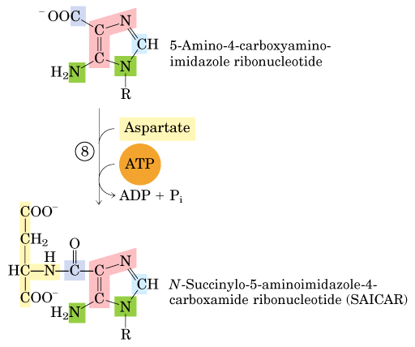

Slide 17
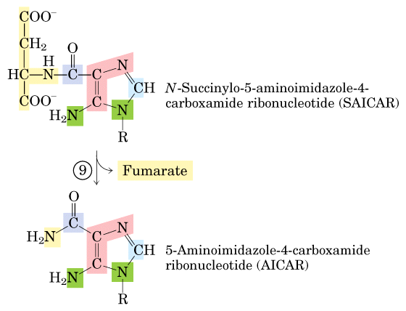

Slide 18
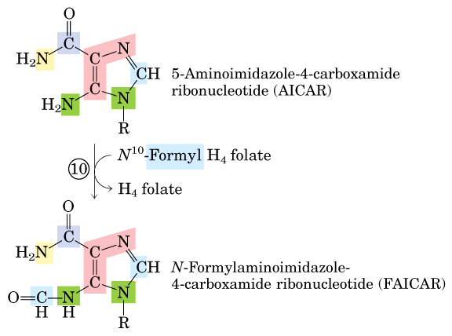

Slide 19
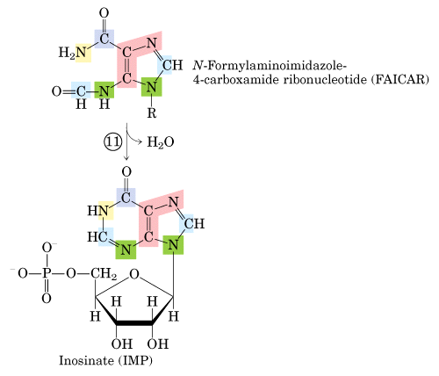

Slide 20
5
origins of the ring
atoms of purines
(numbered is the
order of addition)
6
2
3
7
1
4
Ribose 5-P

Slide 21
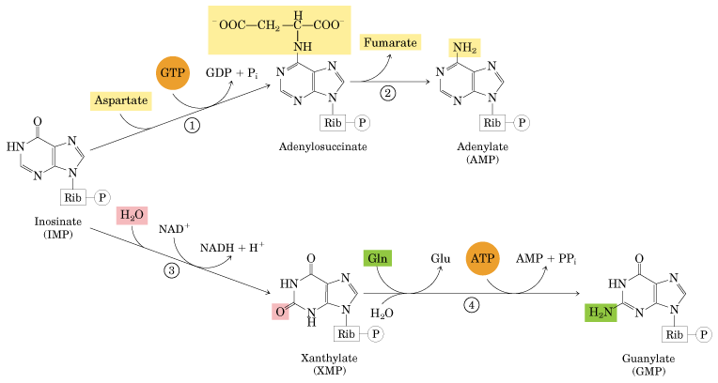
Next

Slide 22
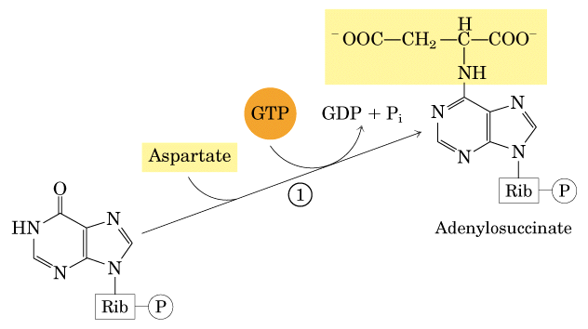

Slide 23
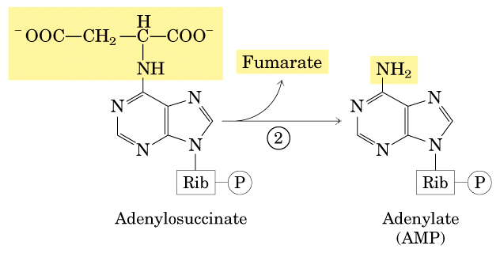

Slide 24
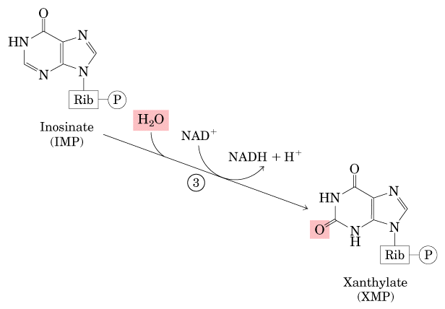

Slide 25
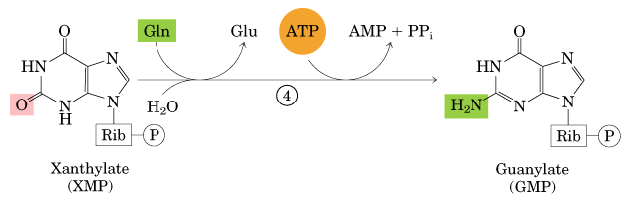

Slide 26
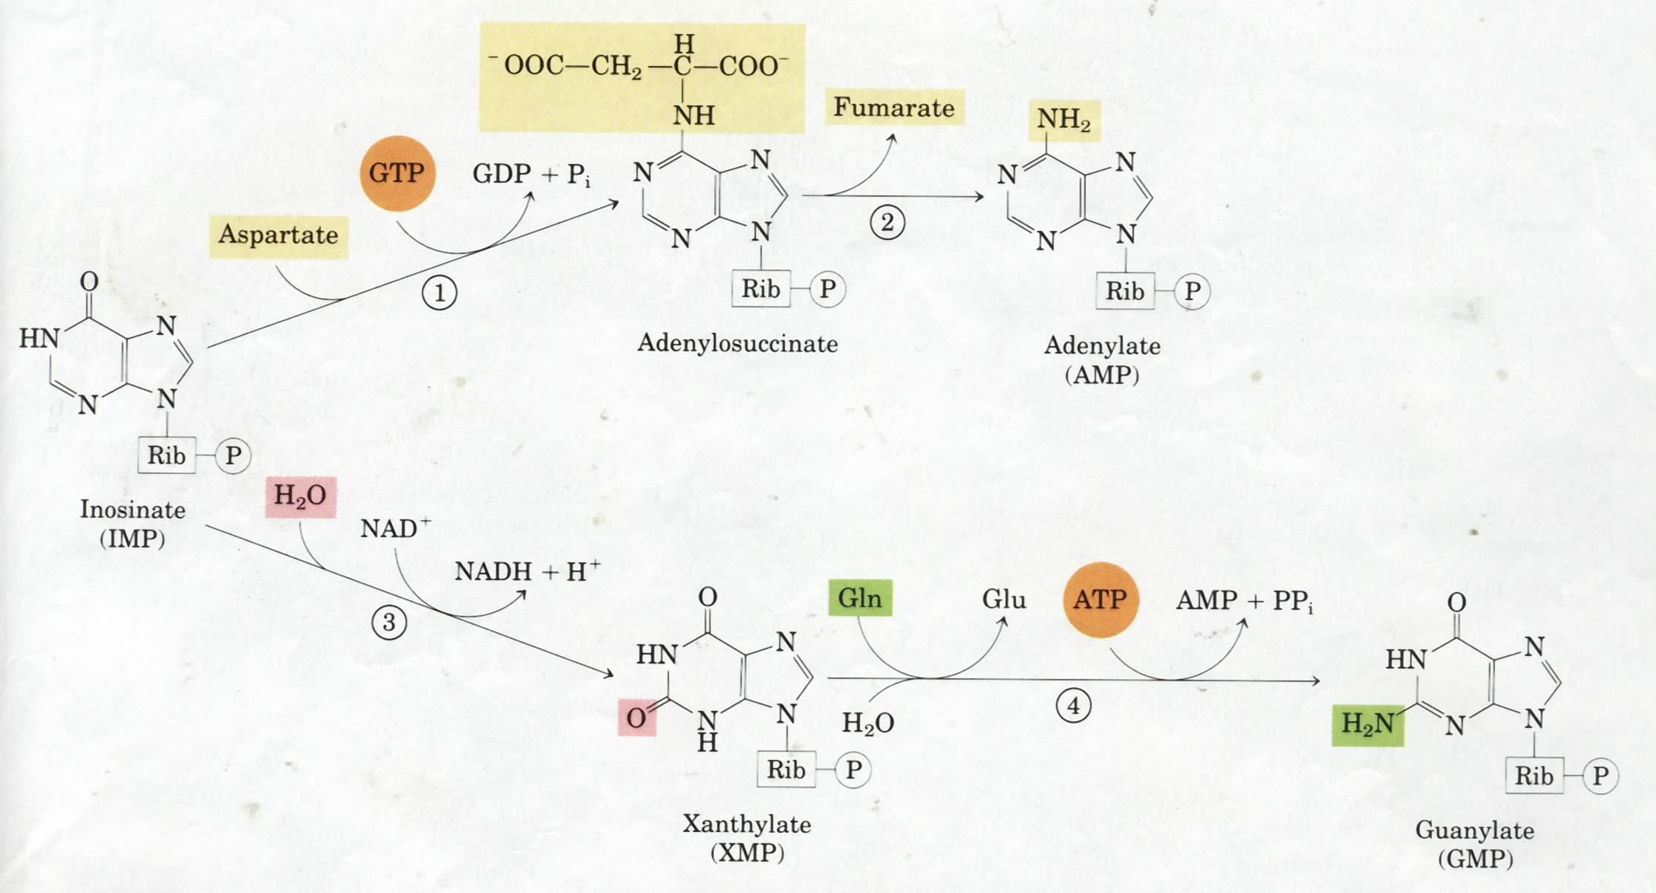
Similar to a step in
the urea cycle
Adenylosuccinate
synthetase
IMP dehydrogenase
XMP-Gln
amidotransferase

Slide 27
The biosynthesis of AMP and GMP is regulated mainly by sequential feedback inhibition (no covalent regulation)

Slide 28
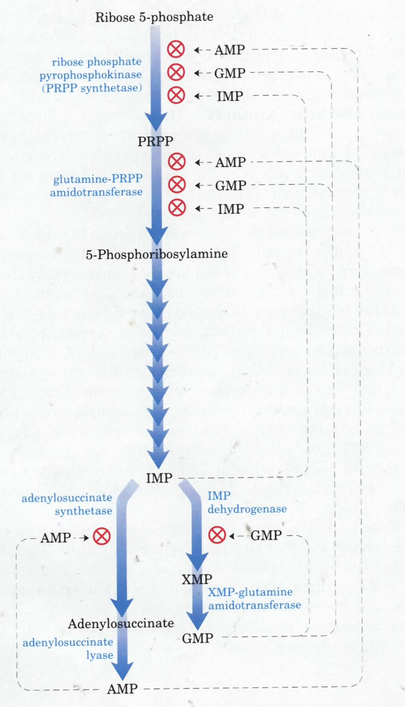
The committing step

Slide 29
The de novo biosynthesis of pyrimidine nucleotides: the base ring (as orotate) is first assembled before being attached to the phosphoribosyl group to form orotidylate

Slide 30
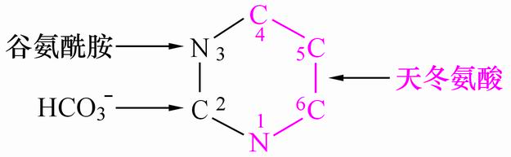

Slide 31
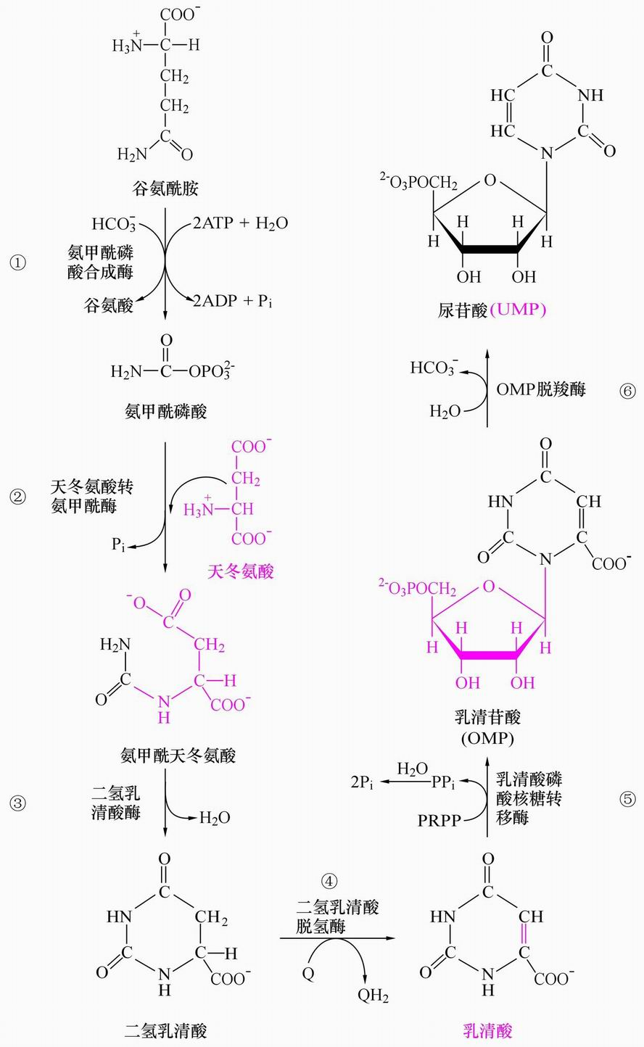

Slide 33
orotate

Slide 35
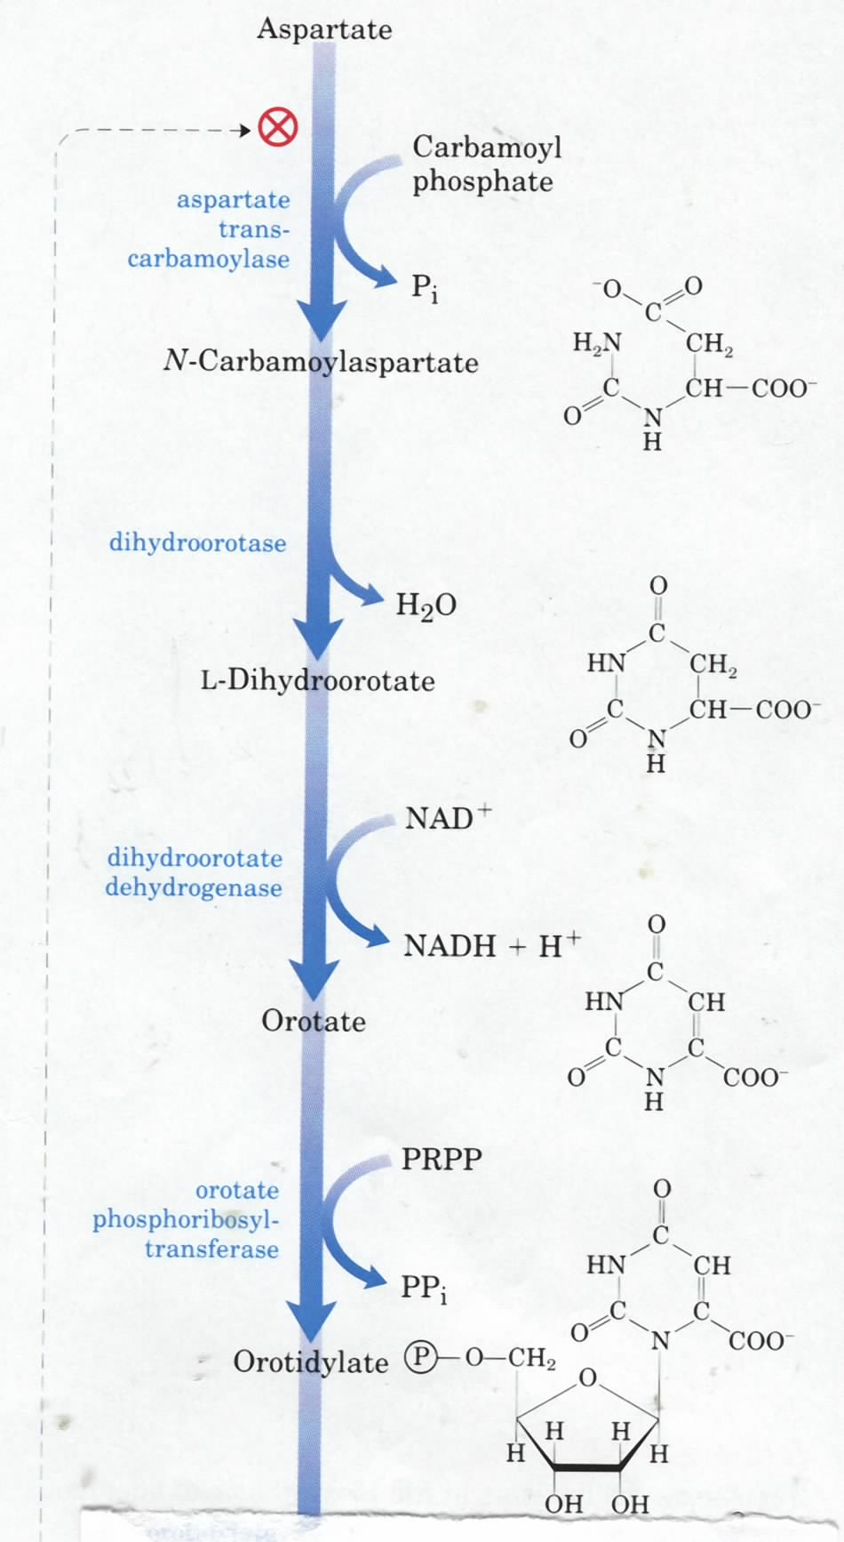
Committing
step
carbamoyl phosphate
synthetase II
Gln, HCO₃⁻
ATP
Asp transcarbamoylase
(ATCase)
Newly formed bond
乳清酸
乳清苷酸

Slide 36
UTP and CTP are then derived from orotidylate via decarboxylation and amination reactions

Slide 37
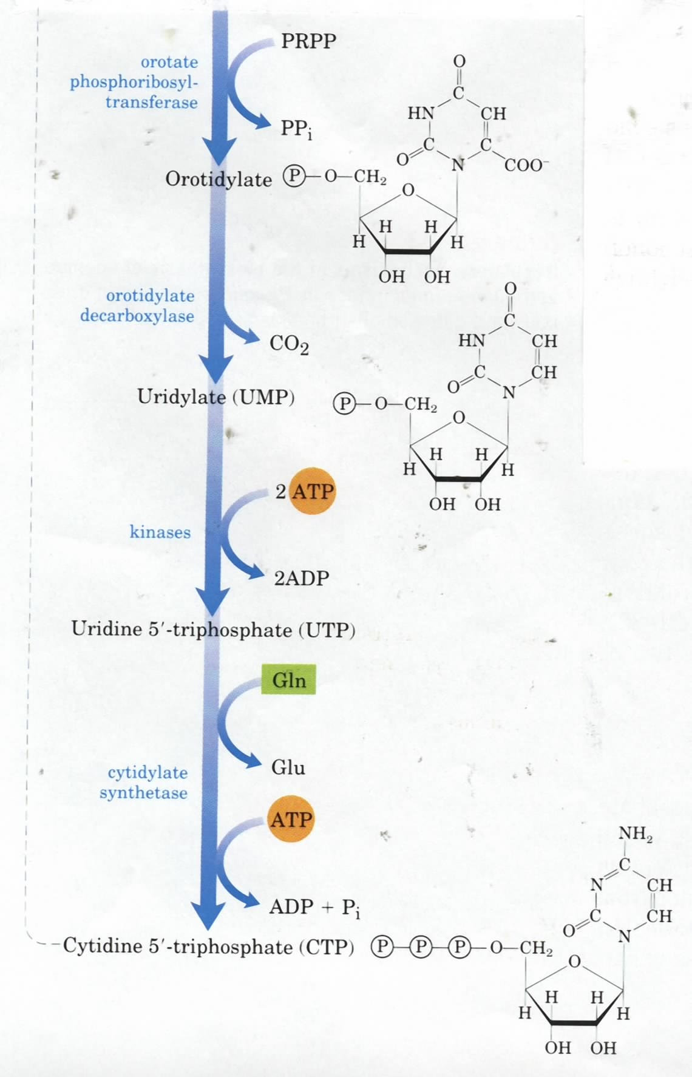
decarboxylation

Slide 38
All dNDPs are derived from NDPs via the catalysis of a common ribonucleotide reductase.

Slide 39
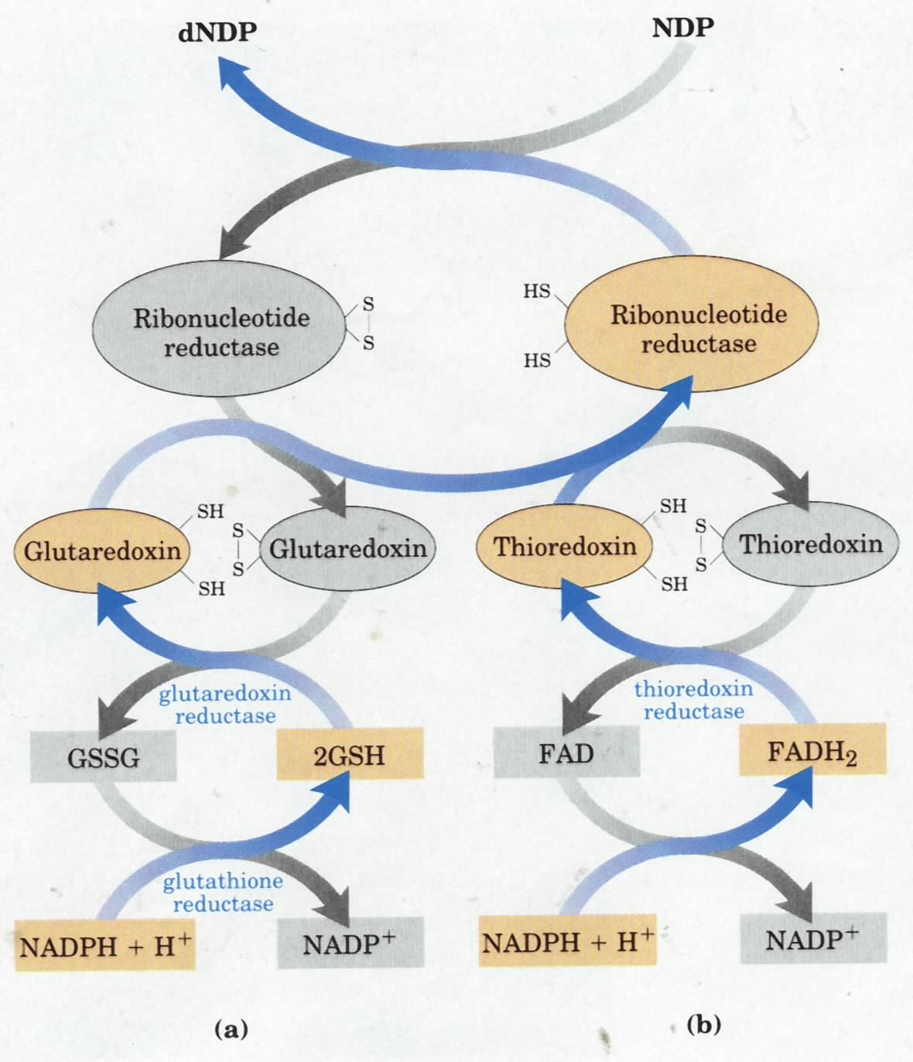
Electrons for ribonucleotide reductase
catalysis ultimately come from NADPH

Slide 40
dTMP is synthesized by the methylation of dUMP

Slide 41
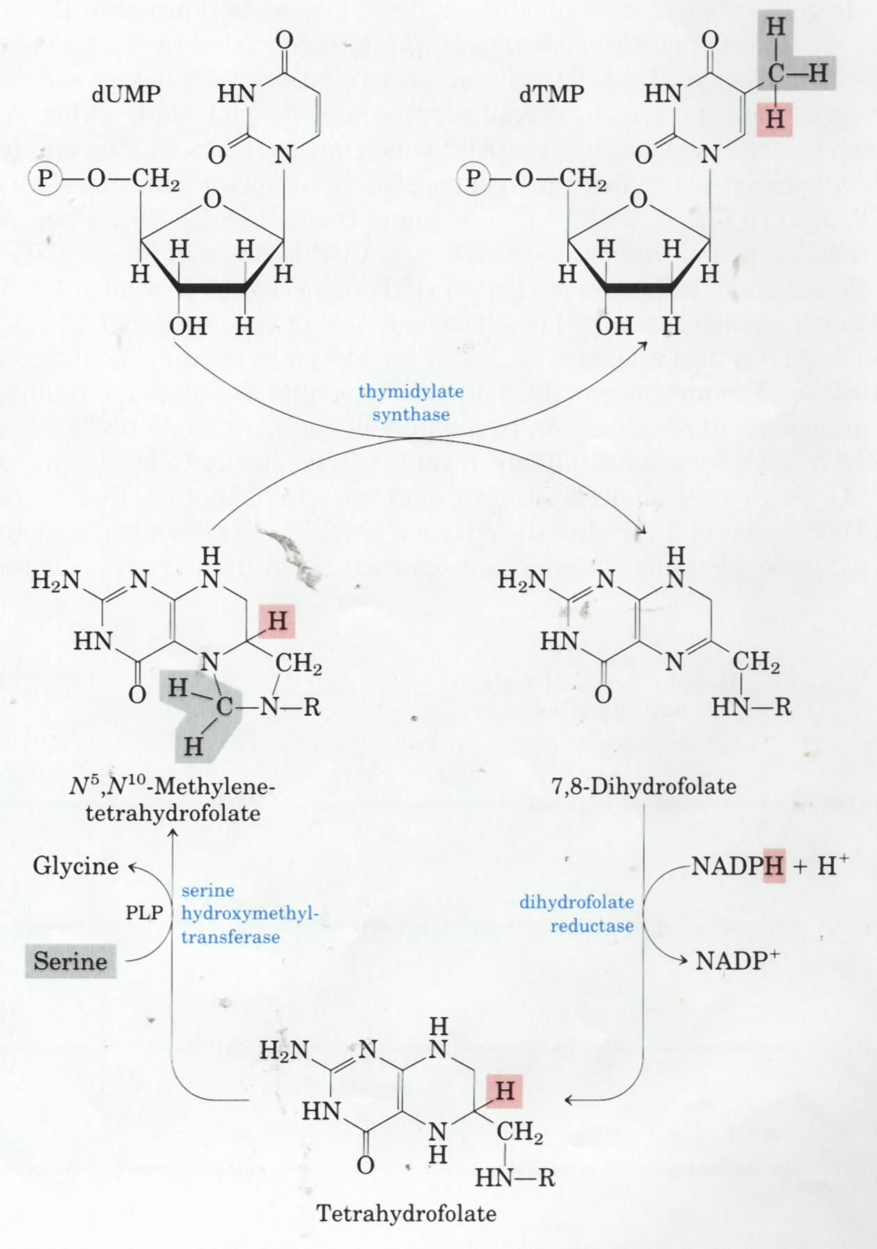
dUMP
dTMP
Thymidylate
synthase
(donors of one-carbon
units & electrons)

Slide 42
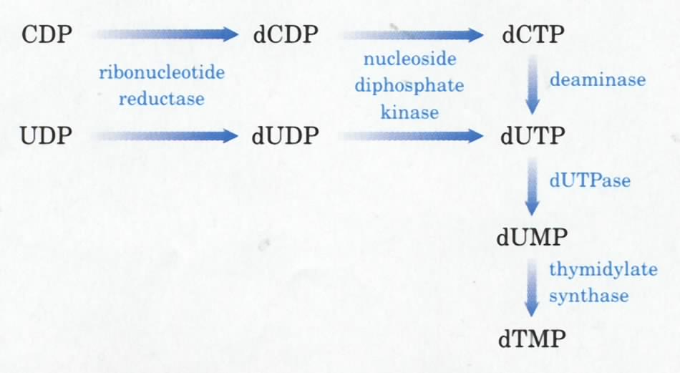
dUMP is derived from dUTP,
which is in turn derived from
dCTP or dUDP.

Slide 43
UMP转变为CTP和dTMP
UMP
UDP dUDP
UTP dUMP
CTP dTMP
尿苷酸激酶
还原酶
二磷酸核
苷激酶
CTP合成酶
NH3(Gln)
ATP
TMP合成酶

Slide 44
Biosynthesis Nucleotide
IMP (Inosinate肌苷酸、次黄嘌呤核苷酸) ------AMP, GMP
O (orotate乳清酸）------OMP(乳清苷酸)-------UMP----UTP------CTP
Biosynthesis Deoxynucleotide
ADP-----dADP
GDP----dGDP
CDP-----dCDP
UDP----dUDP----dUMP----dTMP

Slide 45
Purine and pyrimidine bases can be reconverted to nucleotides via the salvage pathway

Slide 46
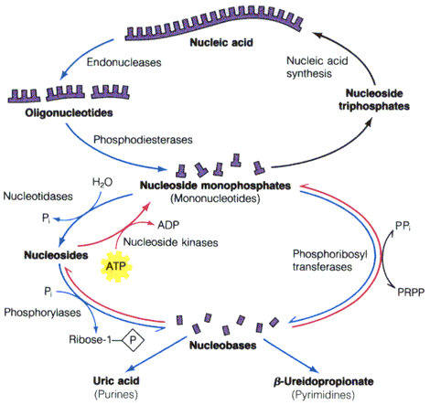
Adenine or hypoxanthine-guanine
phosphoribosyltransferases

Slide 47
核酸的酶促降解
核酸酶 核苷酸酶 核苷酸磷酸化酶
核酸 核苷酸 核苷 碱基+戊糖
磷酸
Next

Slide 48
核 酸 酶
1、核酸酶的分类
核糖核酸酶(RNase)
脱氧核糖核酸酶(DNase)
（1）根据对底物的 专一性分为
非特异性核酸酶
核酸内切酶
（2）根据切割位点分为
核酸外切酶
核酸内切兼外切酶

Slide 49
1、外切核酸酶对核酸的水解位点
B
B
B
B
B
B
B
B
5´
p
p
p
p
p
p
p
p
OH
3´
牛脾磷酸二酯酶（ 5´端外切5 3）
蛇毒磷酸二酯酶（ 3´端外切3 5）
非特异性核酸酶，作用于DNA、RNA

Slide 50
2、内切核酸酶对RNA的水解位点示意图
Py
Pu
Py
Py
G
A
C
U
G
A
1´
p
p
p
p
p
p
p
p
p
p
OH
5´
3´
RNase I
RNase I
RNase T₁
RNase T₁
曲霉核酸酶
牛胰核酸酶
Pu ：嘌呤 Py：嘧啶
特异性核酸酶，只作用于RNA或DNA

Slide 51
3、脱氧核糖核酸酶
特异性核酸酶，只作用于DNA
B
B
B
B
B
B
B
B
5´
p
p
p
p
p
p
p
p
OH
3´
牛脾脱氧核糖核酸酶（DNase II）
牛胰脱氧核糖核酸酶（DNase I）

Slide 52
限制性内切酶
原核生物中存在着一类能识别外源DNA双螺旋中4-8个碱基对所组成的特异的序列，并在此序列的某位点水解DNA双螺旋链，产生粘性末端或平齐末端，这类酶称为限制性内切酶（restriction endonuclease）。
具有很强的专一性， 有特异的识别位点，通常具有二重旋转对称性的回文序列 (palindromic sequence )

Slide 53
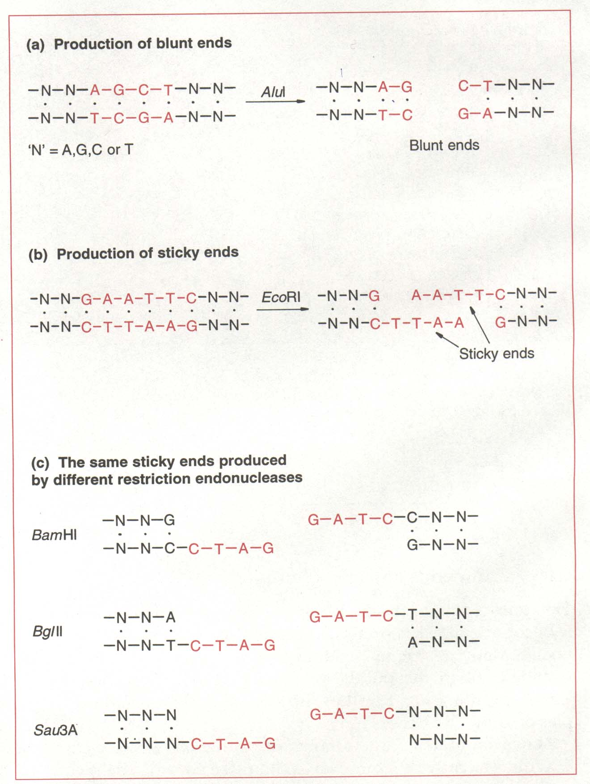

Slide 54
核苷酸分解代谢
核苷酸酶 核苷磷酸化酶（DNA、RNA）
核苷酸 核苷 碱基+戊糖－1－磷酸
核苷水解酶 碱基+戊糖
磷酸
RNA
1、嘌呤的降解
2、嘧啶的降解

Slide 55
嘌呤的分解
腺嘌呤和鸟嘌呤要经过脱氨氧化转变为黄嘌呤再进行降解
不同生物分解嘌呤的酶系不一样
生物进化程度愈高，分解嘌呤的能力愈差

Slide 56
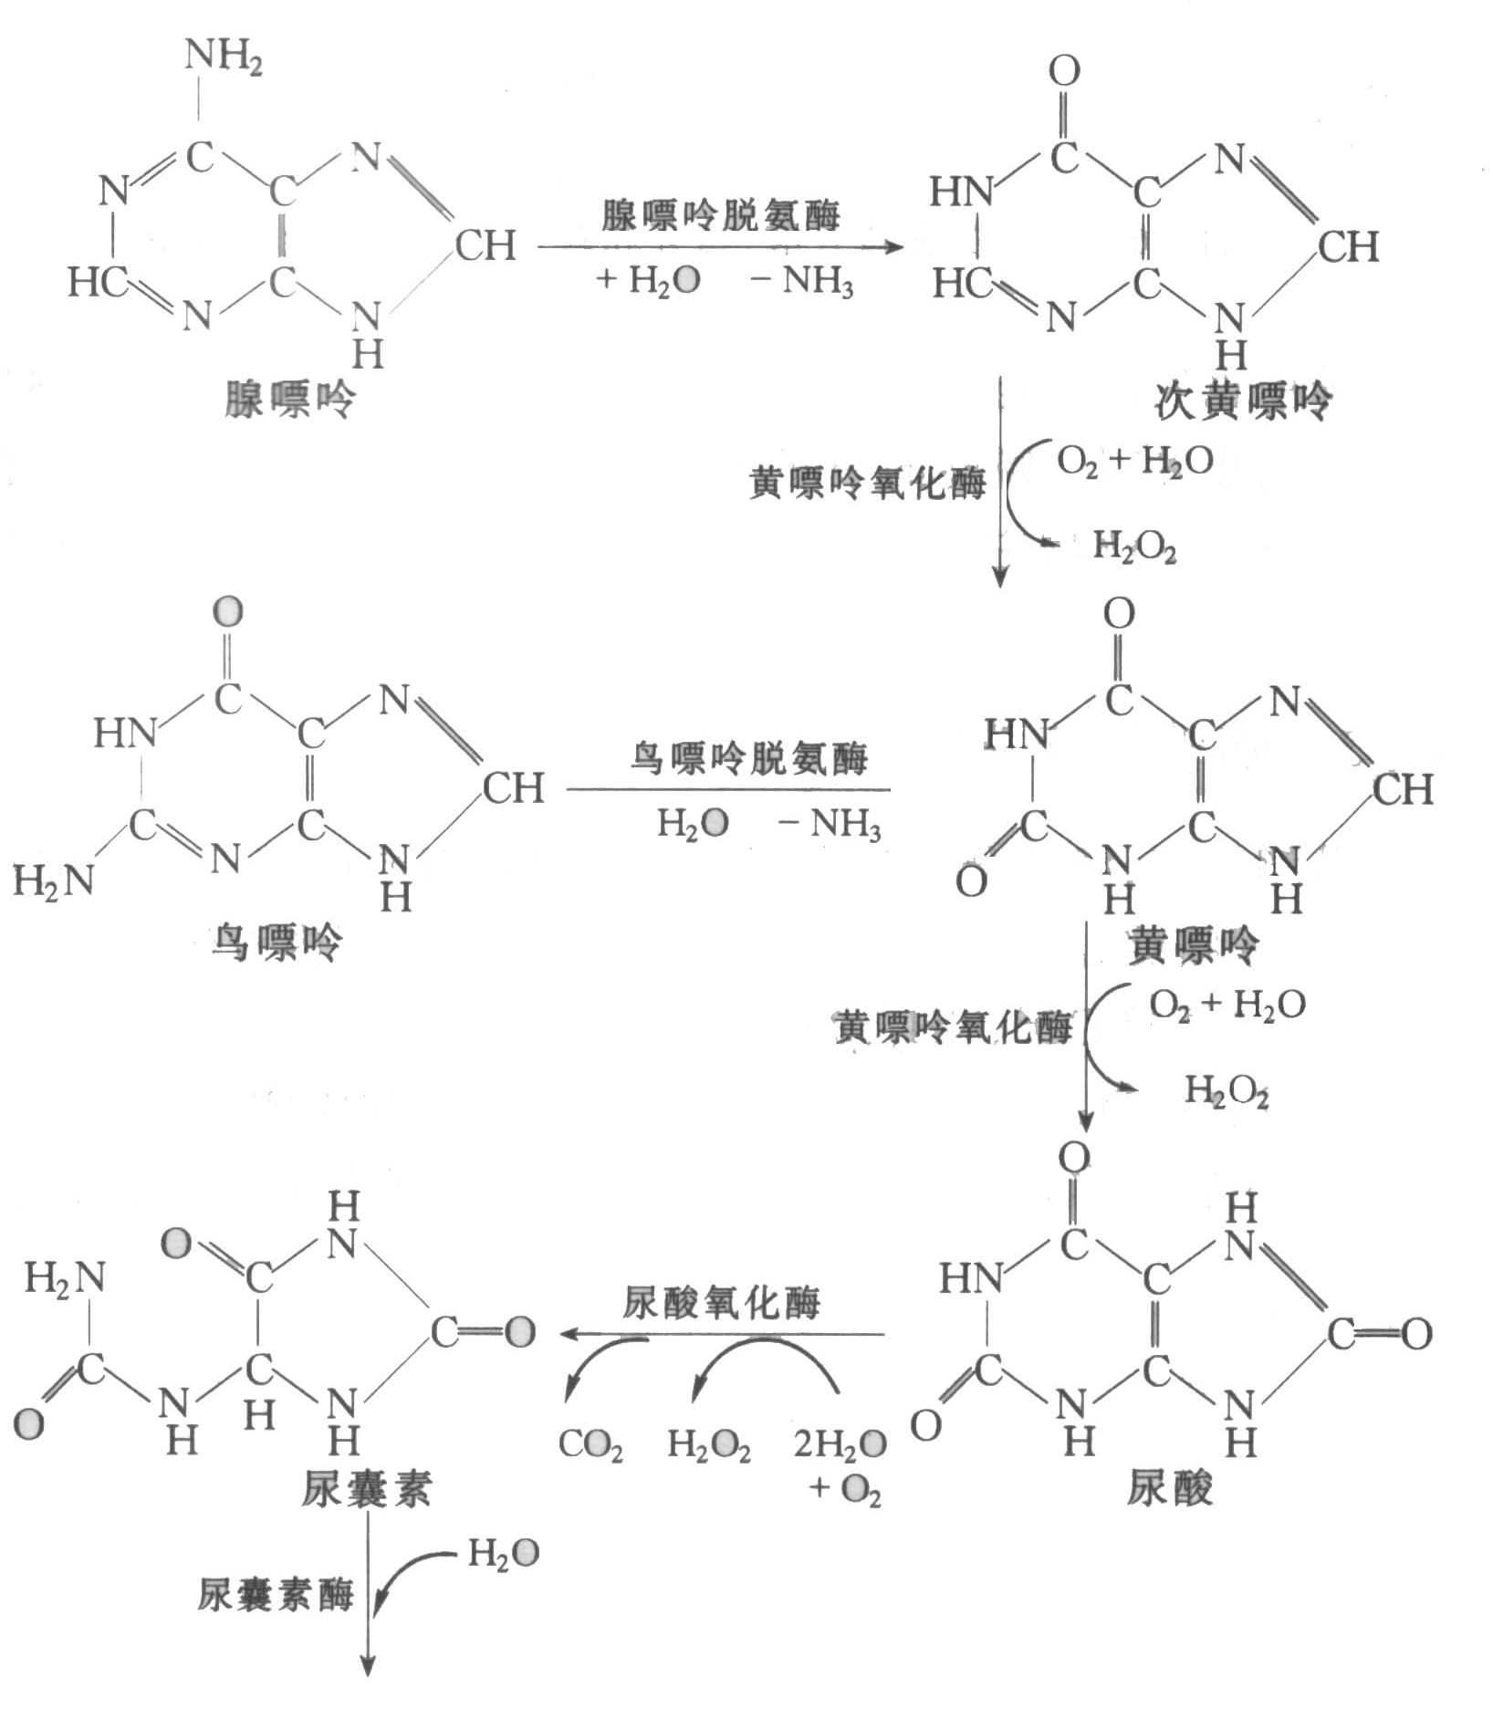
非灵长类哺乳动物
人、猿、鸟
尿素
乙醛酸
CO₂
NH₃
硬骨鱼
尿囊酸
鱼类、两栖类
低等无脊椎动物

Slide 57
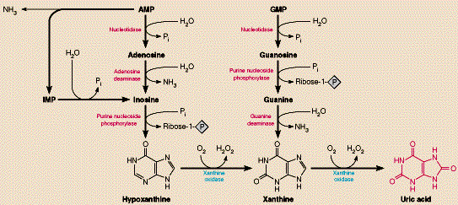
AMP deaminase
Oxidation of GMP
and AMP to produce
uric acid
nucleotidase
nucleotidase
Adenosine
Deaminase
ADA)
purine nucleoside
phosphorylase
Overproduction of
uric acid, which
will accumulate
in the joints, was
revealed to cause
gout (痛风).
purine nucleoside
phosphorylase
guanine
deaminase
The deficiency of
ADA will cause
severe combined
immunodefficiency
(SCID) in human.
Xanthine
oxidase
Xanthine
oxidase

Slide 58
Uric acid is the excreted end product of purine nucleotide catabolism in humans and many other animals.

Slide 59

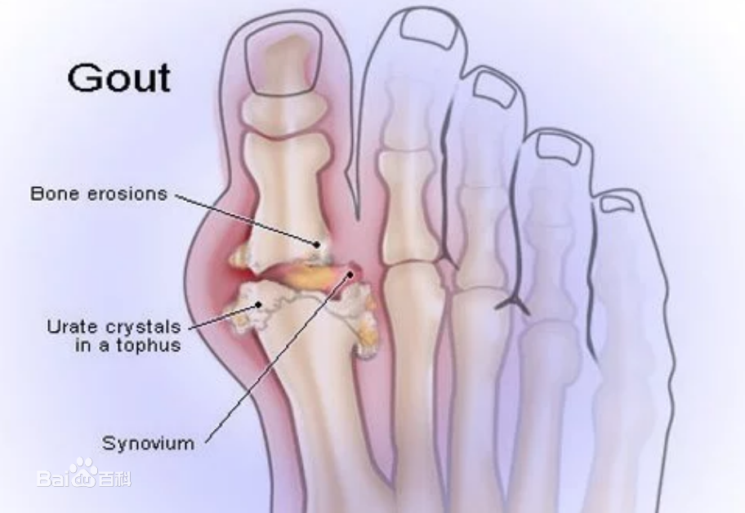
关键酶：黄嘌呤氧化酶
抑制剂－别嘌呤醇
最终产物：尿酸
正常人：血尿酸 119-357 μmol/L （2-6 mg/dl）
男 267.7 μmol/L （4.5 mg/dl）
女 208.2 μmol/L （3.5 mg/dl）
血尿酸 > 8 mg/dl
结晶
沉积组织
痛风（gout）

Slide 60
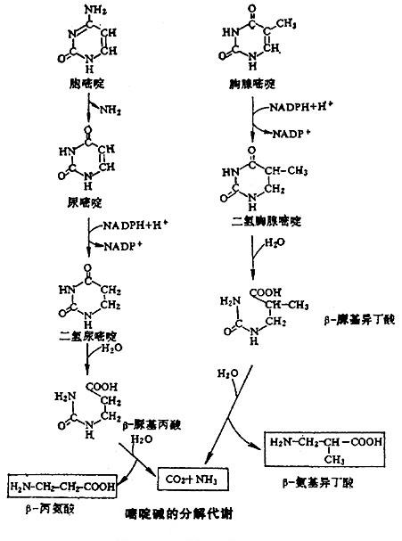
嘧啶的分解
脱氨基
还原
打破环内双键
水解
开环
再水解

Slide 61
END
Thank you

Slide 62
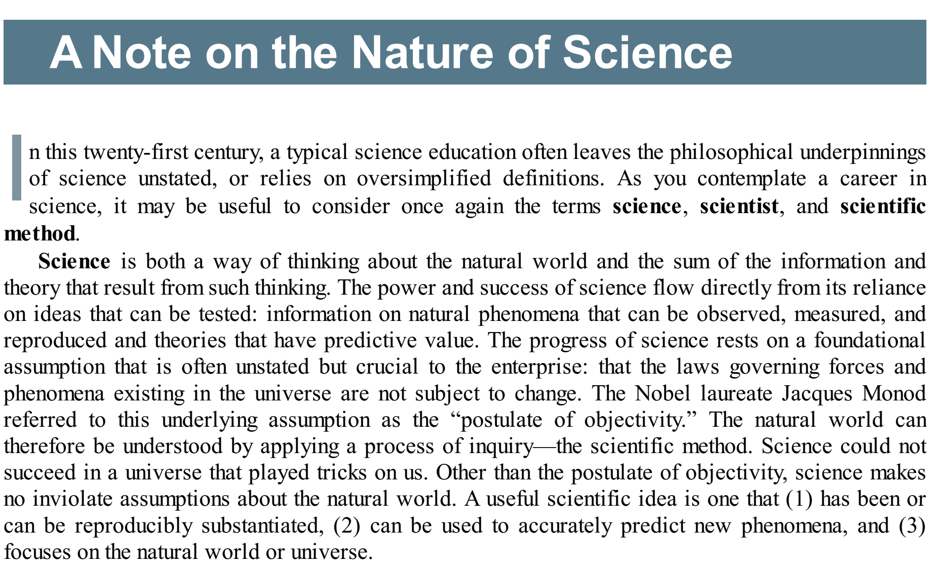

Slide 63
Science is both a way of thinking about the natural world and the sum of the information and theory that result from such thinking.
The power and success of science flow directly from its reliance on ideas that can be tested: information on natural phenomena that can be observed, measured, and reproduced and theories that have predictive value.

Slide 64
Scientists are individuals who rigorously apply
the scientific method to understand the natural world.
Merely having an advanced degree in a scientific discipline does not make one a scientist, nor does the lack of such a degree prevent one from making important scientific contributions.
A scientist must be willing to challenge any idea when new findings demand it.

Slide 65
The scientific method is actually a collection of paths, all of which may lead to scientific discovery.
In the hypothesis and experiment path, a scientist poses a hypothesis, then subjects it to experimental test.
An analog of hypothesis and experiment is hypothesis and deduction.
Crick reasoned that there must be an adaptor molecule that facilitated translation of the information in messenger RNA into protein. This adaptor hypothesis led to the discovery of transfer RNA by Mahlon Hoagland and Paul Zamecnik.

